Slide 1

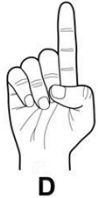
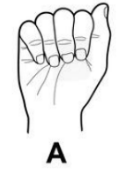
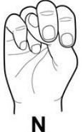
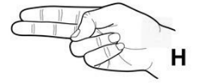
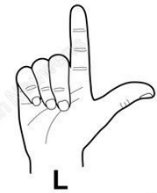
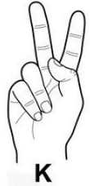
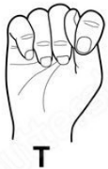






HandTalk: Real-Time Hand Sign Recognition
H
A
N
D
An American sign language to text convertor Application
T
A
L
K
By : Atul Kumar
Id : 58042
MCA Final Year
Advisory Committee:
Dr. Shri Prakash Dwivedi
Chairman
Assistant Professor, IT Department
Er. Sanjay Joshi
Member
Assistant Professor, IT Department
Er. Rajesh Singh
Member
Assistant Professor, IT Department

Slide 2
TABLE OF CONTENTS
Introduction
Problem Statement
Solution Strategy
Technologies Used
Working Mechanism
Use Case
System Preview
Implementation
Advantages
Current Advancements in Gesture Recognition
Future Possibilities

Slide 3
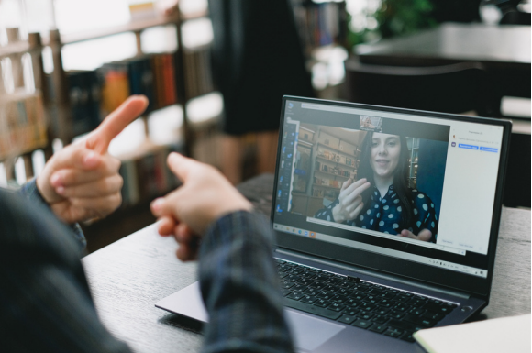
INTRODUCTION
Sign language is a visual-manual language that is used by many deaf and hard-of-hearing individuals as their primary means of communication.
It consist of a series of gestures and movements made with the hands, arms and face and can include facial expressions and body language.
The project is to design a system that recognizes hand sign representing 26 English alphabets where each given a sign.

Slide 4
PROBLEM STATEMENT
Communication is one of the most powerful tools for human interaction and connection, and the inability to communicate presents a significant real-world challenge for deaf and mute individuals.
According to the World Health Organization (WHO), approximately 1.5 billion people globally experience some degree of hearing loss, and this number is projected to rise to 2.5 billion by 2050.
Key problems that deaf & mute individuals may face in terms of communication:
Limited access to sign language interpreters
Difficulty communicating with people who do not know sign language, which can lead to social isolation and frustration.
Limited access to technology and communication devices designed for the deaf community, such as video phones and text messaging services.
Misunderstandings and misinterpretations due to differences in sign language regional variations, or limited sign language proficiency among some people.

Slide 5
SOLUTION STRATEGY
The design of a Real-Time Sign Language Recognition system basically involves:
Collect dataset of every alphabet in varying lighting conditions.
Build and train the model using CNN architecture considering ASL Dataset.
Testing involves:
Acquiring user’s hand gesture at real-time
Classifying hand gestures using trained CNN Model.
Text to Speech Conversion
Word suggestions

Slide 6





TECHNOLOGIES USED
Programming Language
Frontend
Backend
Mediapipe
Python
Tkinter
OpenCV
Tensorflow

Slide 7
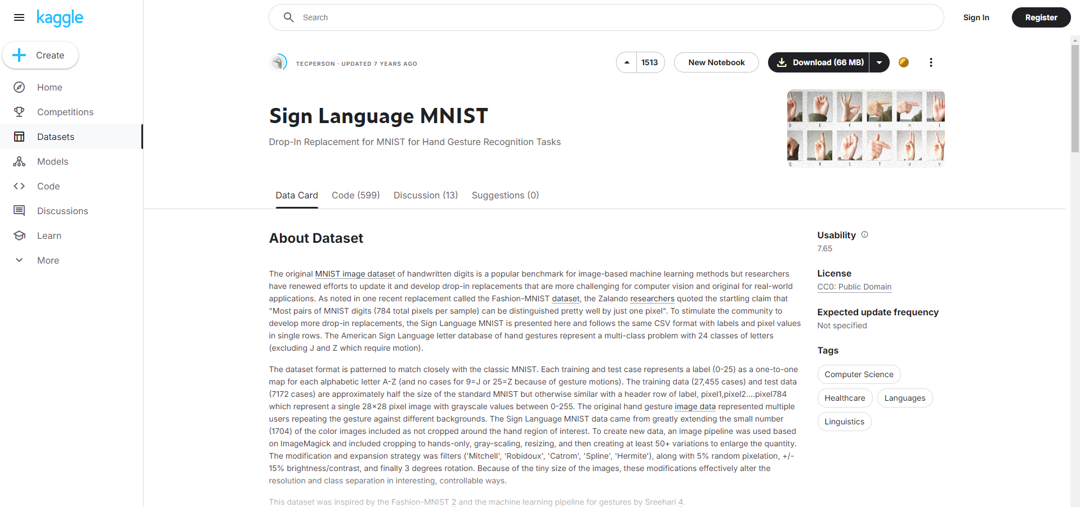
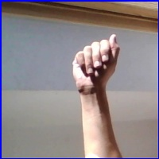
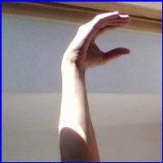
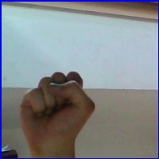
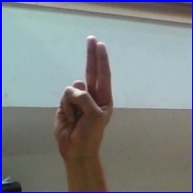
WORKING MECHANISM
Data Collection and Preprocessing
Initially, we utilized a dataset sourced from Kaggle and preprocessed it with the VGG16 preprocessing function.
However, the results obtained under varying lighting conditions were not as anticipated, so we captured our own hand gesture images.
Kaggle Dataset
Own Dataset

Slide 8
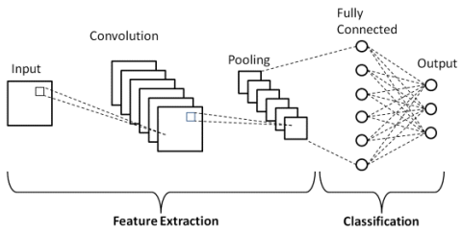
WORKING MECHANISM
Convolutional Neural Network Architecture Selection
We implemented the following layers in our model:
Conv2D - Convolutional Layer, used for feature extraction
MaxPooling2D - Calculates largest value in every patch
Flatten - 2D array to linear vector
Dense - Deeply connected layer

Slide 9
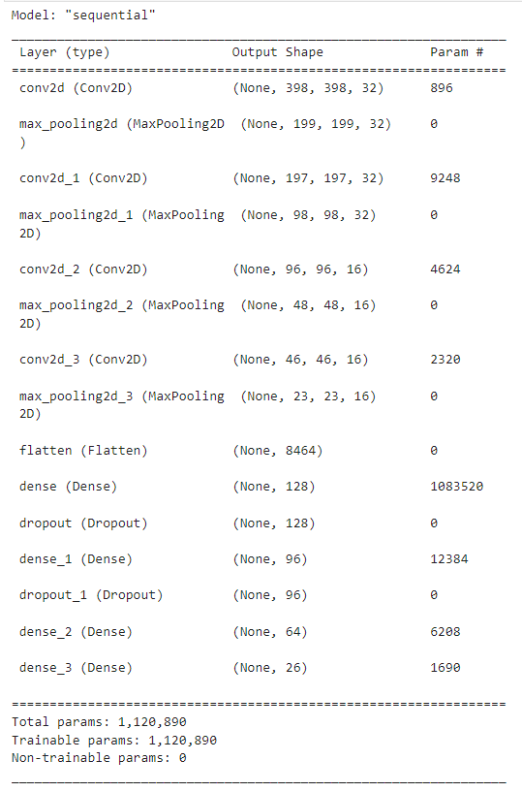
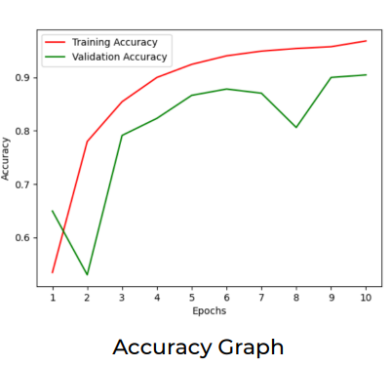
WORKING MECHANISM
Model Creation and Training (Before Feature Extraction)
Model Structure
Accuracy Graph

Slide 10
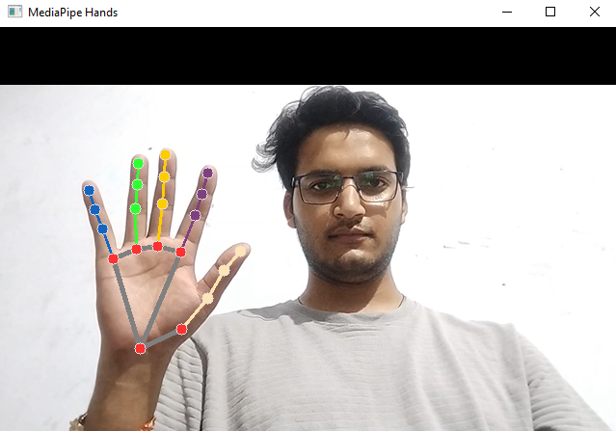
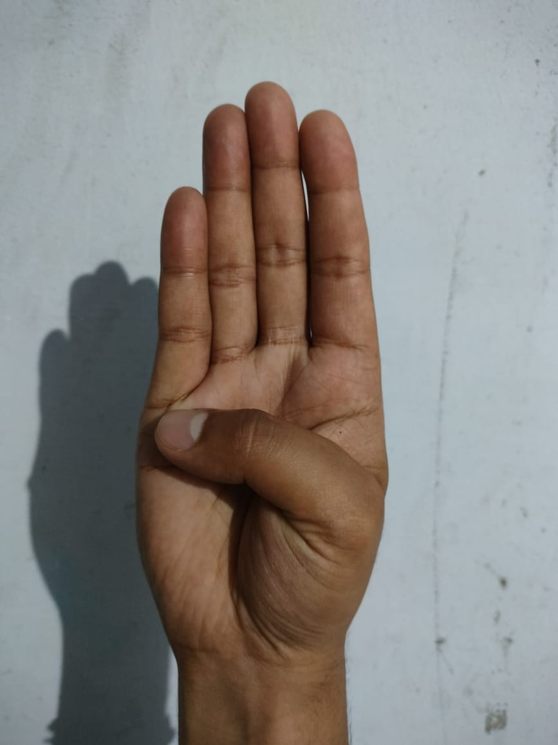
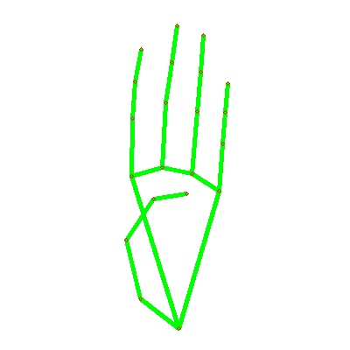
WORKING MECHANISM
Google's MediaPipe Library For Feature Extraction
Landmark using Mediapipe
Uneven Lightning Condition Image
Landmark Extracted Image

Slide 11
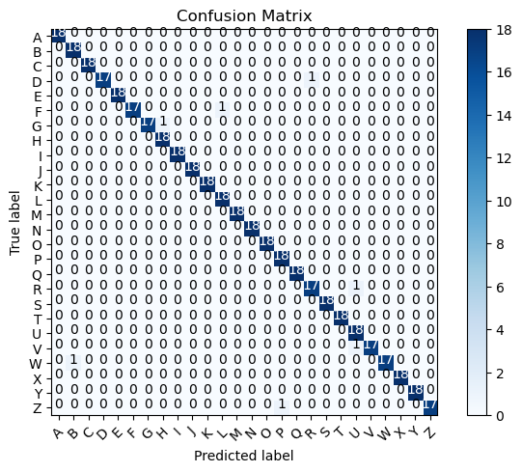
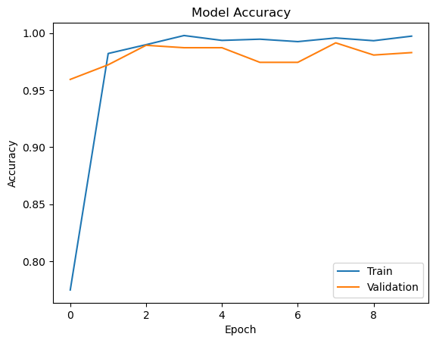
WORKING MECHANISM
Model Creation and Training (After feature extraction using Mediapipe)
Confusion Matrix
Accuracy Graph

Slide 12
WORKING MECHANISM
Data Collection & Training Model
Image from Camera/ Local
Partition Training & Testing Data
Is accuracy good?
Yes
Image Resize
Training CNN Based Classifier
Test on test Dataset
No
Feature Extraction
Tuning of CNN Model
Save Model
Data Storage of Images

Slide 13
WORKING MECHANISM
Prediction (Using trained model)
Live frames From Camera
Is Predicted ‘backspace’?
Suggest Word From Enchant
Image Resize
No
Is Predicted ‘next’?
Yes
Feature Extraction
Predict Alphabet
With Model
Add Alphabet To Word
Speak Word
Load Pretrained TF Model From Local Storage

Slide 14
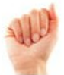
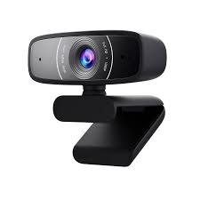
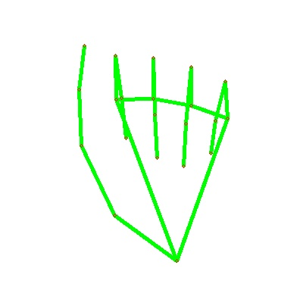

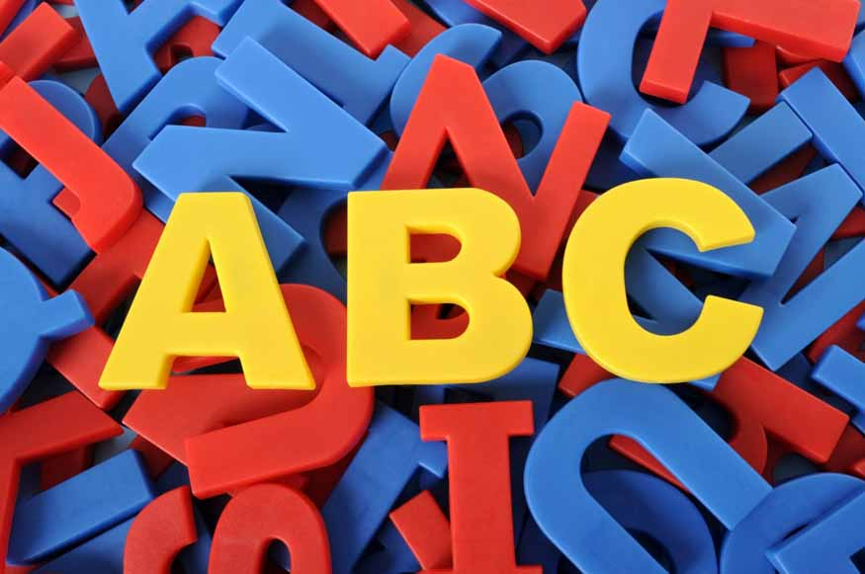
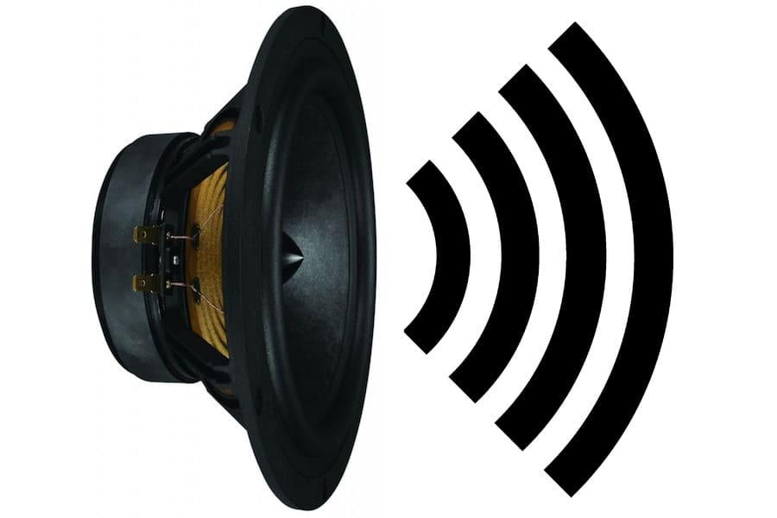
USE CASE
HELLO
Making Hand Sign
Webcam
Capture
Feature
Extraction
Trained Model
Predicting
Alphabet
Creating Whole Word
Text to Speech

Slide 15
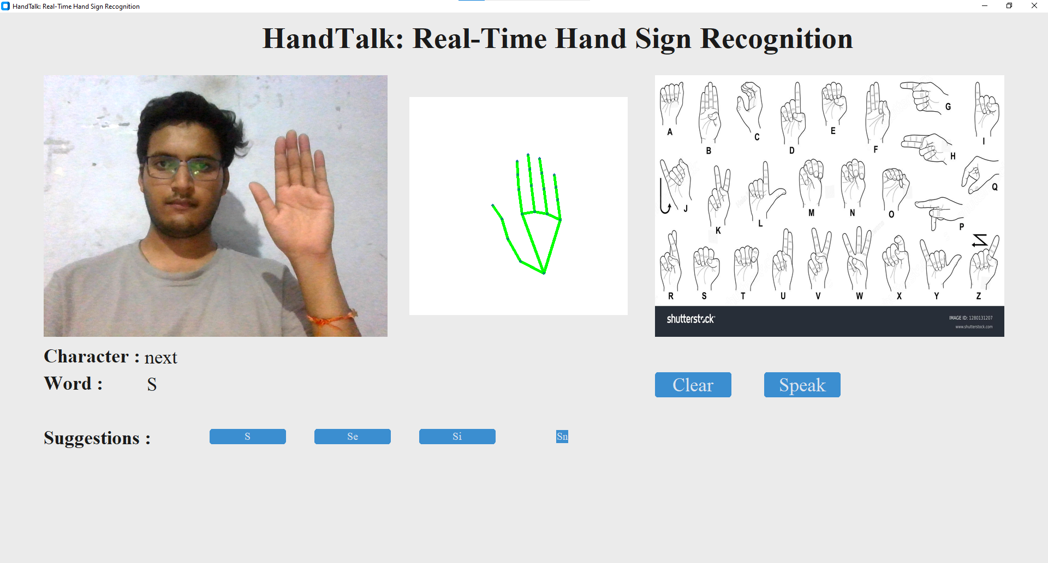
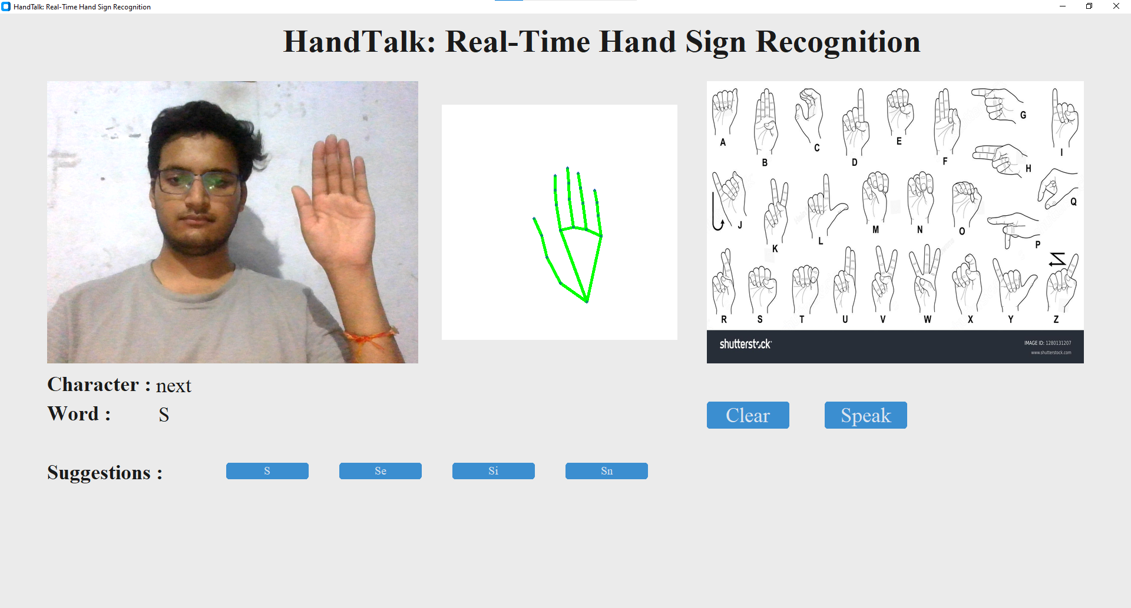
SYSTEM PREVIEW
Writing word “Success”
Predicting Alphabet “S”
Adding S using “next” Sign

Slide 16

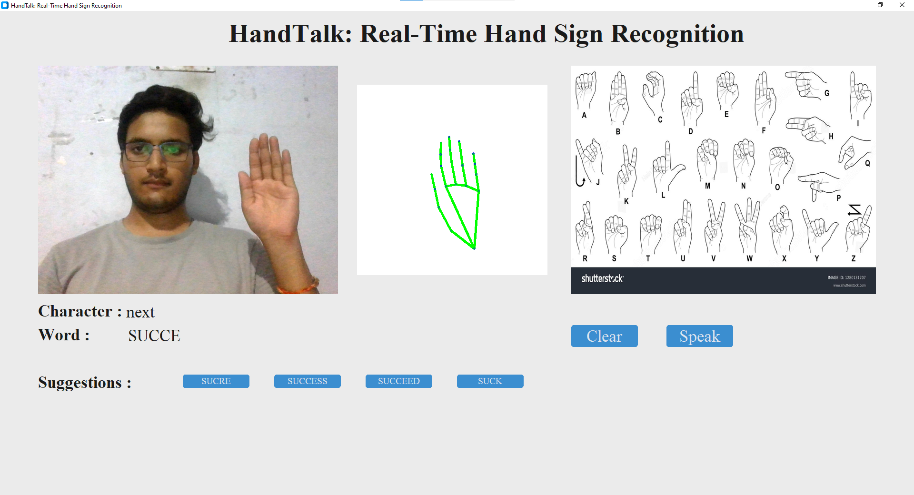
SYSTEM PREVIEW
Writing word “Success”
Predicting word “U”
By following same procedure written “SUCCE”
and Suggestion already given for word “SUCCESS”

Slide 17
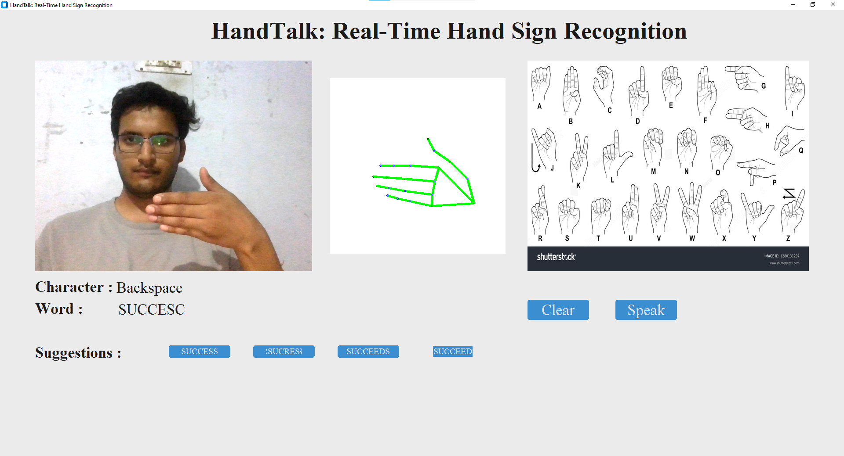
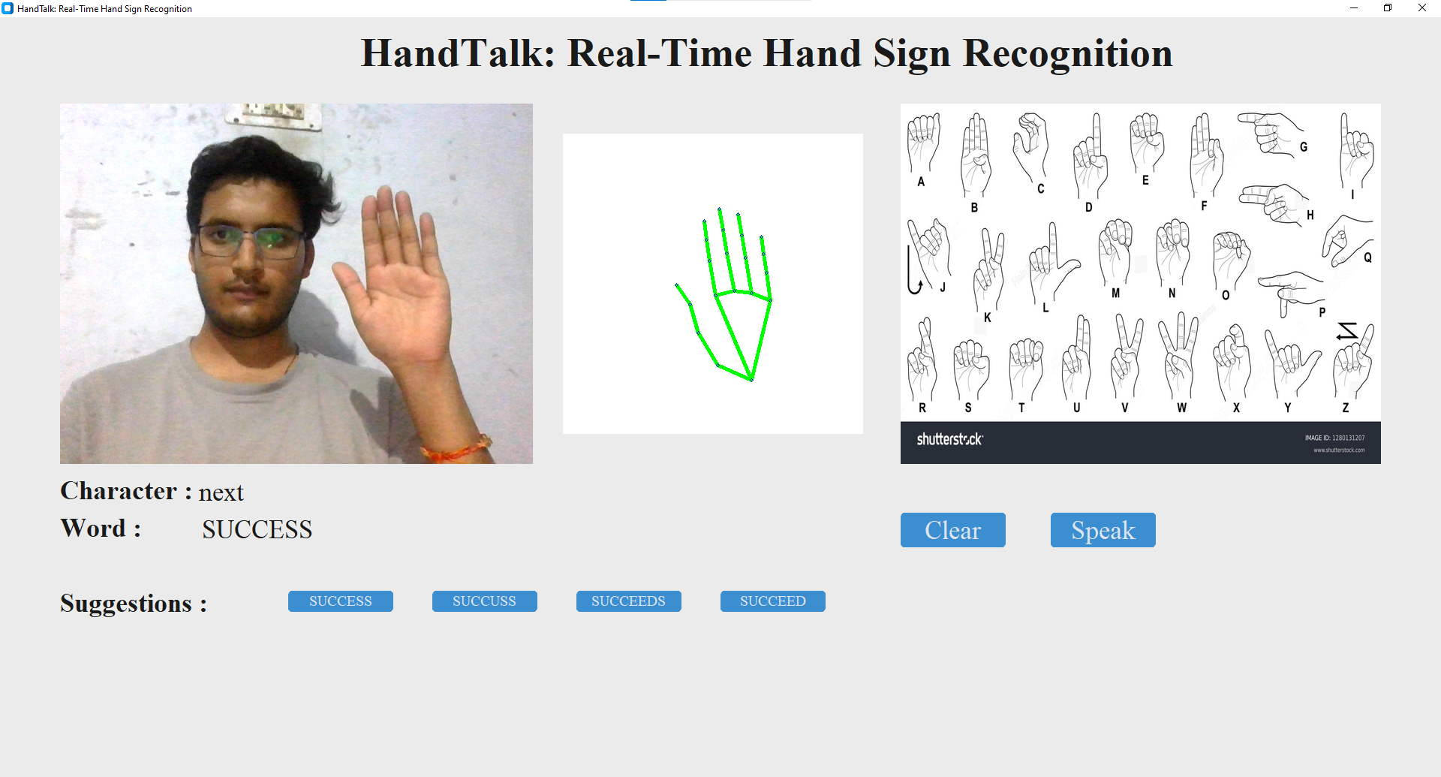
SYSTEM PREVIEW
Writing word “Success”
If any alphabet goes wrong, using “Backspace”
to remove it
Completing Word “SUCCESS”
Now we can use Speak button
For text-to-speech

Slide 18
IMPLEMENTATION
Data Collection & Preprocessing: Collected hand gesture images and preprocessed them for training.
Initial Model Training: Used a simple CNN model for hand sign classification; results were below expectations.
Improvement with Mediapipe: Switched to Mediapipe for feature extraction, leading to significant improvement in accuracy.
System Integration: Integrated the model into a Desktop-based application using Tkinter.
Real-Time Detection: Implemented real-time hand sign detection using Mediapipe.
Testing & Validation: Validated the model with a test set, achieving higher accuracy compared to the initial CNN approach.

Slide 19
ADVANTAGES
Real-Time Hand Sign Recognition
User-Friendly Interface
MediaPipe integration making model more accurate
Word Suggestions
Integration with Speech
No internet connection required
Customizable Dataset (Create own dataset using MediaPipe & Train Model)

Slide 20
CURRENT ADVANCEMENTS IN GESTURE RECOGNITION
Deep Learning Models for Gesture Recognition
Multi-modal Input Integration
Gesture Recognition on Mobile Devices
Gesture Recognition in Augmented Reality (AR) and Virtual Reality (VR)
Gesture Recognition for Human-Computer Interaction (HCI)

Slide 21
FUTURE POSSIBILITIES
Full Gesture Sentence Recognition
Improved Accuracy in Challenging Conditions
Cross-Language Sign Recognition
Real-Time Translation for Conversations
Wearable Gesture Recognition Devices

Slide 22
PROJECT DEMO

Slide 23
THANK YOU

